Slide 1
Predicting Home Credit Client’s Payment Abilities
Bhara Yudhiantara
28 September 2018

Slide 2
Outline
Understanding the Problem
Data Checking and Formatting
Exploratory Data Analysis
Baseline Model
Improved Model
Summary

Slide 3
Understanding the Problem
Many people struggle to get loans due to insufficient or non-existent credit histories. This population is often taken advantage of by untrustworthy lenders.
Predicting client’s repayment abilities will help ensuring this underserved population has a positive loan experience.
Predicting client’s repayment abilities will also ensure that clients capable of repayment are not rejected and that loans are given with a principal, maturity, and repayment calendar that will empower their clients to be successful.

Slide 4
Data Checking and Formatting
Source of Data
There are 7 different sources of data, this project will only use application_train data as the baseline for analysis since it is still manageable to work with the current tool.
Application_train: the main data with information about each loan application at Home Credit. Every loan has its own row and is identified by the feature SK_ID_CURR. The training application data comes with the TARGET indicating 0: loan repaid on time or 1: the loan was not repaid.

Slide 5
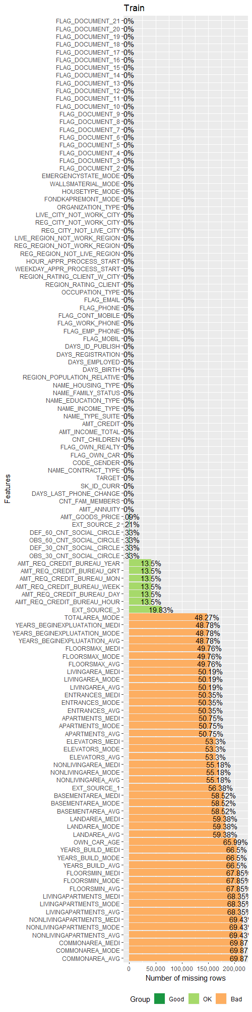
Data Checking and Formatting (cont.)
Missing Data: it can be a great noise since we can have misleading information of the distribution of the data.

Slide 6
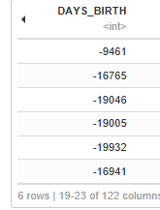
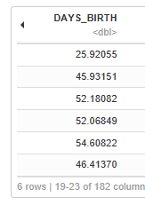
Data Checking and Formatting (cont.)
Anomaly Data
DAYS_BIRTH values are negative which don’t make sense. Dividing the variable with -365 will correct the data and generate new information which is approximation of client’s age.

Slide 7
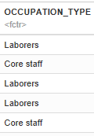
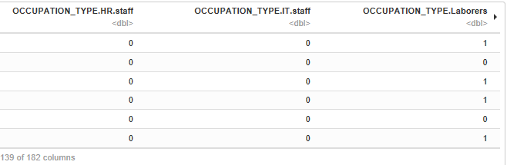
Data Checking and Formatting (cont.)
Recoding Categorical Variable
There are some categorical variables that need to be recoded since they are still in string format e.g. CODE_GENDER, OCCUPATION_TYPE, etc. By recoding them, they are ready to be analyzed as categorical data (nominal and ordinal).

Slide 8
DATA EXPLORATORY ANALYSIS

Slide 9
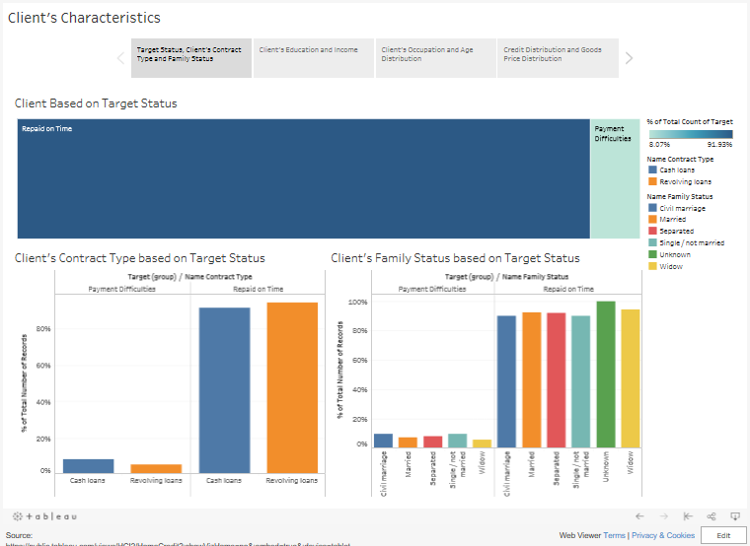
Exploratory Data Analysis

Slide 10
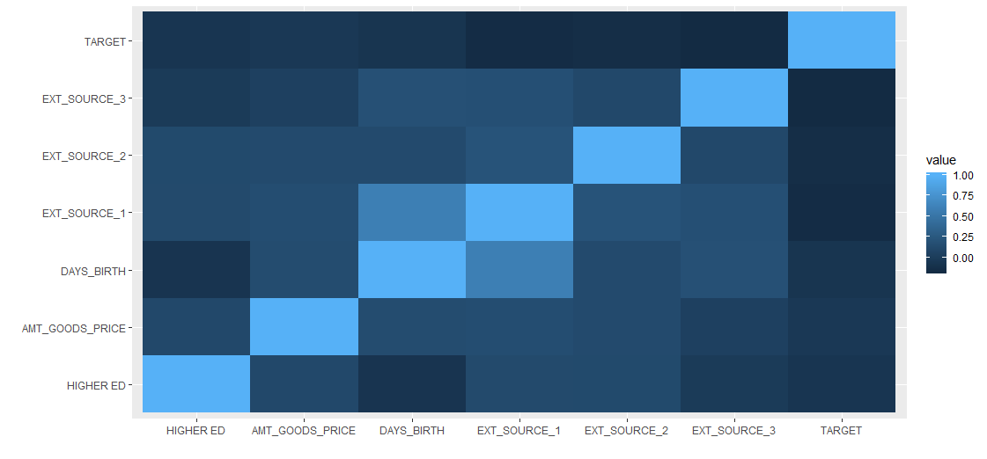
Baseline Model
Check Correlation
From the correlation and industry-related theory, we can make the model hypothesis.

Slide 11
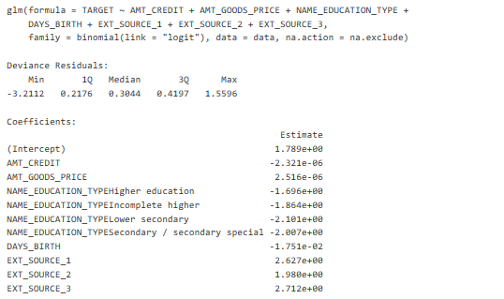
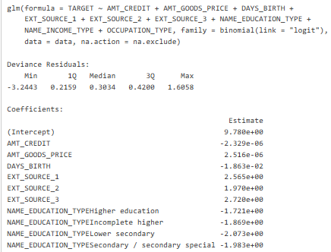
Baseline Model (Cont.)
Logistic Regression
Model 1 (AIC = 63746)
Model 2 (AIC = 63674)

Slide 12
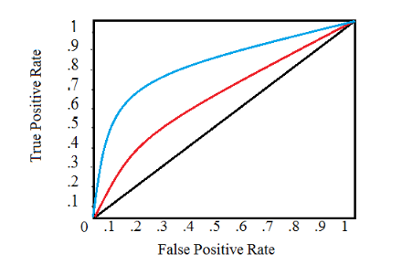
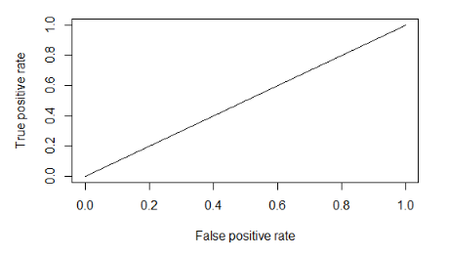
Baseline Model (Cont.)
Idea Behind of Plot ROC
Logistic Regression Performance
AUC = 0.5169

Slide 13
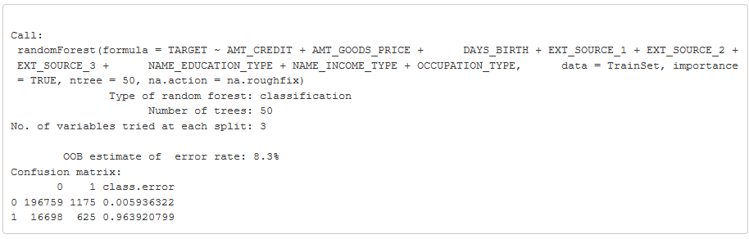
Improved Model
random decision forests are an ensemble learning method for classification, regression and other tasks.
AUC = 0.6899 which is better than logistic regression

Slide 14
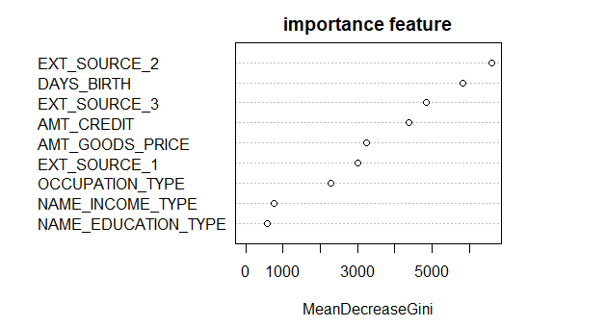
Important Feature

Slide 15
Summary
Predicting client’s repayment abilities is a complex task, since the nature of the data has imbalanced class distribution.
There is no “one clean hit” in modeling, it is a trial error process. Since, it is a computer excessive task, the right technology will improve the results.
From baseline model, we can get the probability of client’s repayment status based on the selected variables. Unfortunately, the model doesn’t have good performance.
Based on improved model, the first three of important feature is credit score from external source 2, client’s age, and credit score from external source 2.
The next question is if the client has repayment difficulties, is it genuine or a fraud attempt?

Slide 16
Source
https://www.kaggle.com/c/home-credit-default-risk
https://www.tandfonline.com/doi/abs/10.1080/00220670209598786
https://medium.com/@williamkoehrsen/random-forest-simple-explanation-377895a60d2d
https://medium.com/greyatom/lets-learn-about-auc-roc-curve-4a94b4d88152

